Slide 1


EMBER: Response to biologics along a gradient of T2 involvement in patients with severe asthma: a data-driven biomarker clustering approach
Eileen Wang, William Henley, Désirée Larenas-Linnemann, Lakmini Bulathsinhala, Trung N. Tran, Michael E. Wechsler, Shawn D. Aaron, Mona Al-Ahmad, Riyad Al-Lehebi, Alan Altraja, Peter Barker, Aaron Beastall, Andrey S. Belevskiy, Celine Bergeron, Leif Bjermer, Unnur S. Björnsdóttir, Sinthia Z. Bosnic-Anticevich, Arnaud Bourdin, Guy G. Brusselle, John Busby, Giorgio Walter Canonica, Victoria Carter, Kenneth R. Chapman, Nicholas Chapman, George C. Christoff, Borja G. Cosio, Richard W. Costello, James Fingleton, João A.ioa Fonseca, Mina Gaga, Peter G. Gibson, Susanne Hansen, Liam G. Heaney, Enrico Heffler, Mark Hew, Takahiko Horiguchi, Flavia Hoyte, Richard B. Hubbard, Takashi Iwanaga, David J. Jackson, Rohit Katial, Mariko Siyue Koh, Konstantinos Kostikas, Piotr Kuna, Sverre Lehmann, Lauri Lehtimäki, Renaud Louis, Dóra Lúdvíksdóttir, Njira Lugogo, Bassam Mahboub, Neil Martin, Jorge Máspero, Andrew N. Menzies-Gow, Arjun Mohan, Ruth B. Murray, Tatsuya Nagano, Nikolaos G. Papadopoulos, Andriana I. Papaioannou, Pujan H. Patel, Luis Perez-de-Llano, Diahn-Warng Perng, Matthew J. Peters, Paul E. Pfeffer, MRCP(UK), Paulo Márcio Pitrez, Roy Alton Pleasants, Todor A. Popov, Celeste M. Porsbjerg, Francesca Puggioni, Anna Quinton, Chin Kook Rhee, Mohsen Sadatsafavi, Sundeep Salvi, Giulia Scioscia, Chau-Chyun Sheu, Concetta Sirena, Camille Taillé, Christian Taube, Carlos A. Torres-Duque, Ming-Ju Tsai, Alf Tunsäter, Charlotte Suppli Ulrik, and David B. Price, on behalf of the ISAR EMBER Working Group
Wang E et al. on behalf of the ISAR EMBER Working Group. Response to biologics along a gradient of T2 involvement in patients with severe asthma: a data-driven biomarker clustering approach, JACI: In Practice 2025; in press

Slide 2
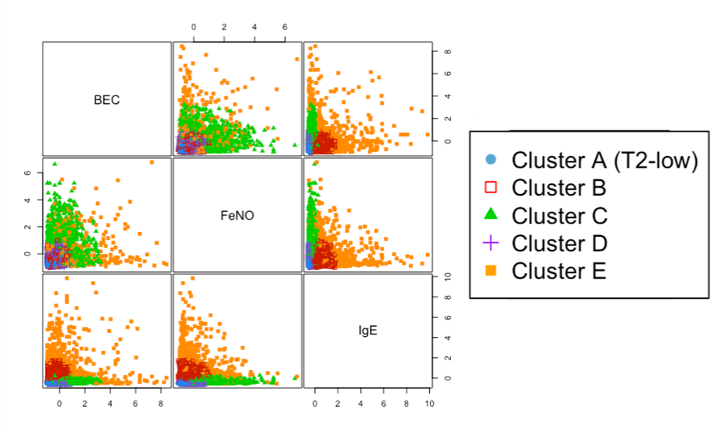
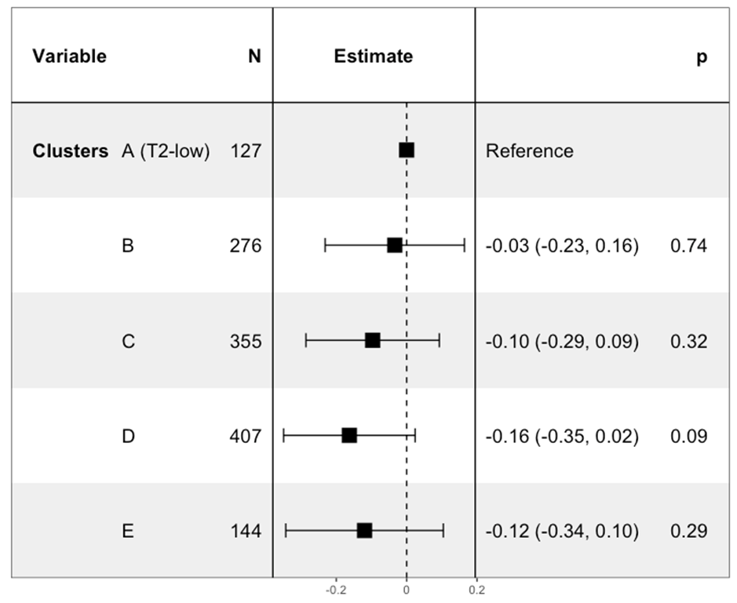
Summary of the EMBER study
Objective
To characterize severe asthma phenotypes and compare pre- to post-biologic change in outcomes along a gradient of T2-involvement.
3,675 patients (23 countries) in ISAR were included; of these, 2,276 received biologics (Anti-IgE, Anti-IL5/5R, Anti-IL4Rα). Clusters were identified using a five-component Gaussian finite mixture model. Change in outcomes between 1 year pre- and post-biologic initiation were compared between clusters and by biologic class.
Methods
Results
Biomarker clusters identified using Gaussian finite mixture model (n=3675)
Change in annualized exacerbation rate pre- to post-biologic relative to Cluster A (T2-low)
Conclusions
Five biomarker clusters along a gradient of T2 involvement were identified using a data-driven approach. Biologic use was associated with improved outcomes in all clusters but tended to be better at the higher end of the T2 spectrum.
BEC: Blood eosinophil count; IgE: Immunoglobulin E; IL4Rα: Interleukin 4-receptor-alpha; IL5/5R: Interleukin 5/5-receptor; FeNO: Fractional exhaled nitric oxide; T2: Type 2
Wang E et al. on behalf of the ISAR EMBER Working Group. Response to biologics along a gradient of T2 involvement in patients with severe asthma: a data-driven biomarker clustering approach, JACI: In Practice 2025; in press

Slide 3
Background and Rationale
~8% of patients in ISAR are T2-low
Much remains unknown about T2-low asthma
No agreed definition or clinical biomarker profile, other than the absence of T2 inflammation
ICS and OCS suppress T2 biomarkers, confounding T2-low categorization
T2-low asthma is less responsive to biologics, which target T2-related pathways
Limited effective treatment options for T2-low asthma
T2-low
ICS: Inhaled corticosteroids; OCS: Oral corticosteroids; T2: Type 2
Wang E et al. on behalf of the ISAR EMBER Working Group. Response to biologics along a gradient of T2 involvement in patients with severe asthma: a data-driven biomarker clustering approach, JACI: In Practice 2025; in press

Slide 4



Aim
Describe distributions of biomarkers in patients with severe asthma along a gradient of T2 involvement
Phenotypically characterize patients along this gradient
Compare the pre- to post-biologic initiation change in asthma outcomes and HCRU across the gradient
Using a data-driven approach instead of pre-defined clinical biomarker cut-offs
HCRU: Healthcare resource utilization; T2: Type 2
Wang E et al. on behalf of the ISAR EMBER Working Group. Response to biologics along a gradient of T2 involvement in patients with severe asthma: a data-driven biomarker clustering approach, JACI: In Practice 2025; in press

Slide 5

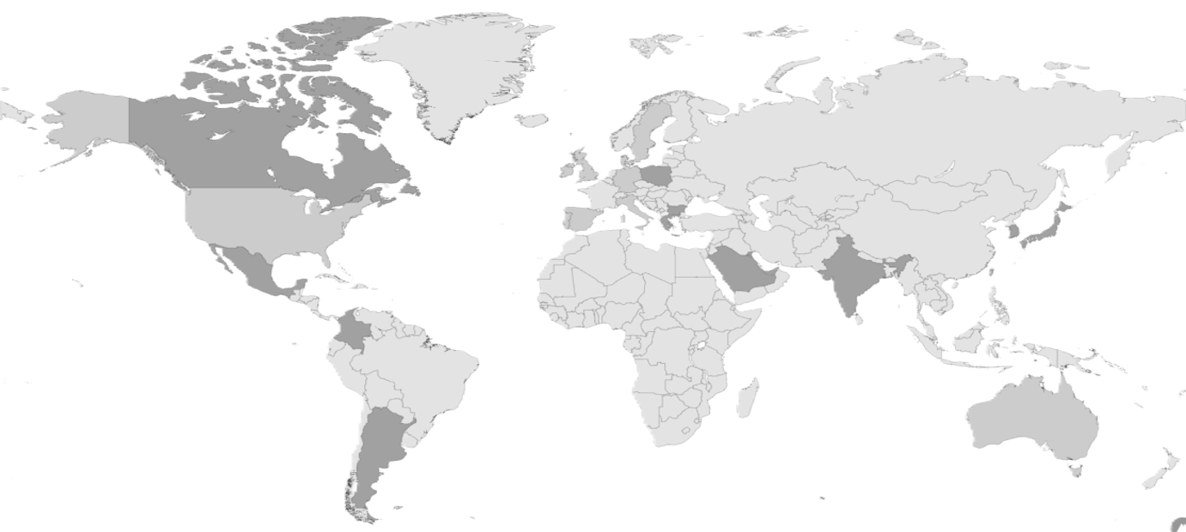
Data source: ISAR
Canada
n = 83
Ireland
n = 16
UK
n = 624
Denmark
n = 174
Poland
n = 1
USA
n = 1,561
Greece
n = 30
Spain
n = 149
Portugal
n = 16
Italy
n = 207
India
n = 22
Japan
n = 79
S. Korea
n = 49
Mexico
n = 3
Bulgaria
n = 4
Kuwait
n = 91
Taiwan
n = 159
Colombia
n = 41
UAE
n = 65
Singapore
n = 40
23 countries
Total patients: 3,675
Saudi Arabia
n = 1
Argentina
n = 36
Australia
n = 223
Wang E et al. on behalf of the ISAR EMBER Working Group. Response to biologics along a gradient of T2 involvement in patients with severe asthma: a data-driven biomarker clustering approach, JACI: In Practice 2025; in press

Slide 6


Methods
Patients
Variables
Statistical analyses
Inclusion criteria
ISAR patients ≥18 years old, severe asthma*
Assessment of biomarker distributions
Pre-biologic data for BEC, FeNO and IgE
Assessment of change in outcomes
Received a biologic
Data for ≥1 asthma outcomes with ≥24 weeks follow-up
Exclusion criteria
Missing outcome data
Outlier biomarker values†
Pre-biologic demographic and clinical characteristics
Pre-biologic biomarkers
BEC, FeNO, IgE
Asthma outcomes:
Annual exacerbation rate
Highest post-bronchodilator FEV₁
Asthma control
HCRU
Biomarker clusters were identified using Gaussian finite mixture models.
Multivariable analysis was conducted with cluster A (T2-low) as reference.
All models were adjusted for pre-biologic outcome, age, sex, pre-biologic long-term OCS use and country.
*Receiving treatment at Global Initiative for Asthma (GINA) 2018 Step 5 or with uncontrolled asthma at GINA Step 4; †BEC >5000 cells/µL; FeNO >500 ppb; IgE >10,000 IU/mL
BEC: Blood eosinophil count; FeNO: Fractional exhaled nitric oxide; FEV₁: Forced expiratory volume in 1 second; HCRU: Healthcare resource utilization; IgE: Immunoglobulin E; OCS: Oral corticosteroids
Wang E et al. on behalf of the ISAR EMBER Working Group. Response to biologics along a gradient of T2 involvement in patients with severe asthma: a data-driven biomarker clustering approach, JACI: In Practice 2025; in press

Slide 7

Patient Flow
Adults with severe asthma (n=14,515)
Exclusions (e.g., missing data, outliers), n=10,840
≥1 pre-biologic biomarker result for BEC, FeNO and IgE
(n=3,675)
Non-biologic initiators, n=1,399
Biologic patients Anti-IgE, Anti-IL5/5R, Anti-IL4Rα
(n=2,276)
Pre- and post-exacerbations (n=1,966)
Pre- and post-FEV₁ (n=1,892)
Pre- and post-asthma control (n=1,287)
Pre- and post-hospital admissions (n=1,893)
*Receiving treatment at Global Initiative for Asthma (GINA) 2018 Step 5 or with uncontrolled asthma at GINA Step 4; †BEC >5000 cells/µL; FeNO >500 ppb; IgE >10,000 IU/mL
BEC: Blood eosinophil count; FeNO: Fractional exhaled nitric oxide; FEV₁: Forced expiratory volume in 1 second; IgE: Immunoglobulin E; IL4Rα: Interleukin 4-receptor-alpha; IL5/5R: Interleukin 5/5-receptor; OCS: Oral corticosteroids
Wang E et al. on behalf of the ISAR EMBER Working Group. Response to biologics along a gradient of T2 involvement in patients with severe asthma: a data-driven biomarker clustering approach, JACI: In Practice 2025; in press

Slide 8

Five biomarker clusters (identified using Gaussian finite mixture models)
Cluster A (16.4%)
T2-low, triple-biomarker-low
Cluster B (20.4%)
High IgE, intermediate BEC
Cluster C (22.9%)
High BEC + FeNO
Cluster D (30.3%)
Triple-biomarker-intermediate
Cluster E (10.0%)
Triple-biomarker-high
n=3,675
BEC: Blood eosinophil count; FeNO: Fractional exhaled nitric oxide; IgE: Immunoglobulin E; T2: Type 2
Wang E et al. on behalf of the ISAR EMBER Working Group. Response to biologics along a gradient of T2 involvement in patients with severe asthma: a data-driven biomarker clustering approach, JACI: In Practice 2025; in press

Slide 9
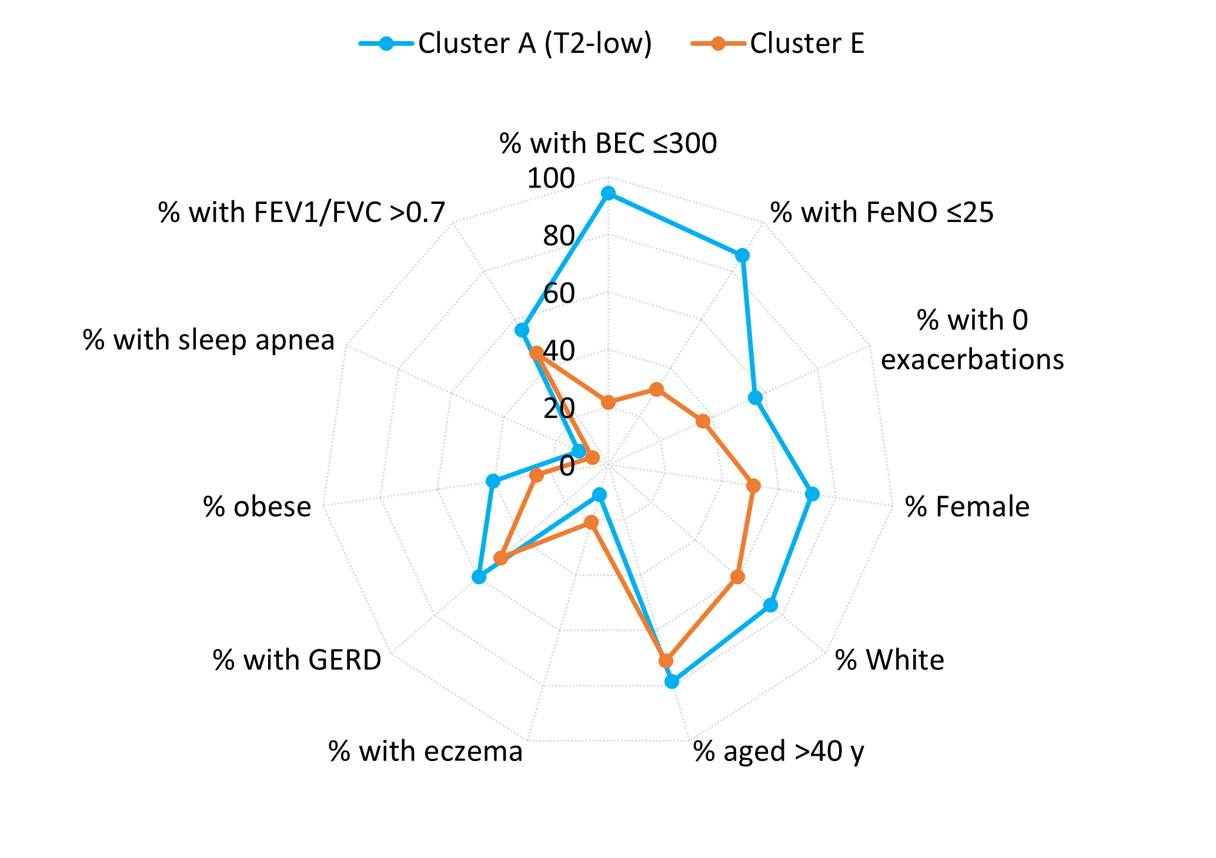
Demographic and clinical characteristics of Clusters A and E
n=602
n=368
Cluster A (vs Cluster E)
Tended to be female, White, and have a lower exacerbation rate
More likely to have GERD and other potentially OCS-related comorbidities
BEC: Blood eosinophil count; FeNO: Fractional exhaled nitric oxide; FEV₁: Forced expiratory volume in 1 second; FVC: Forced vital capacity; GERD: Gastroesophageal reflux disease; IgE: Immunoglobulin E; T2: Type 2
Wang E et al. on behalf of the ISAR EMBER Working Group. Response to biologics along a gradient of T2 involvement in patients with severe asthma: a data-driven biomarker clustering approach, JACI: In Practice 2025; in press

Slide 10
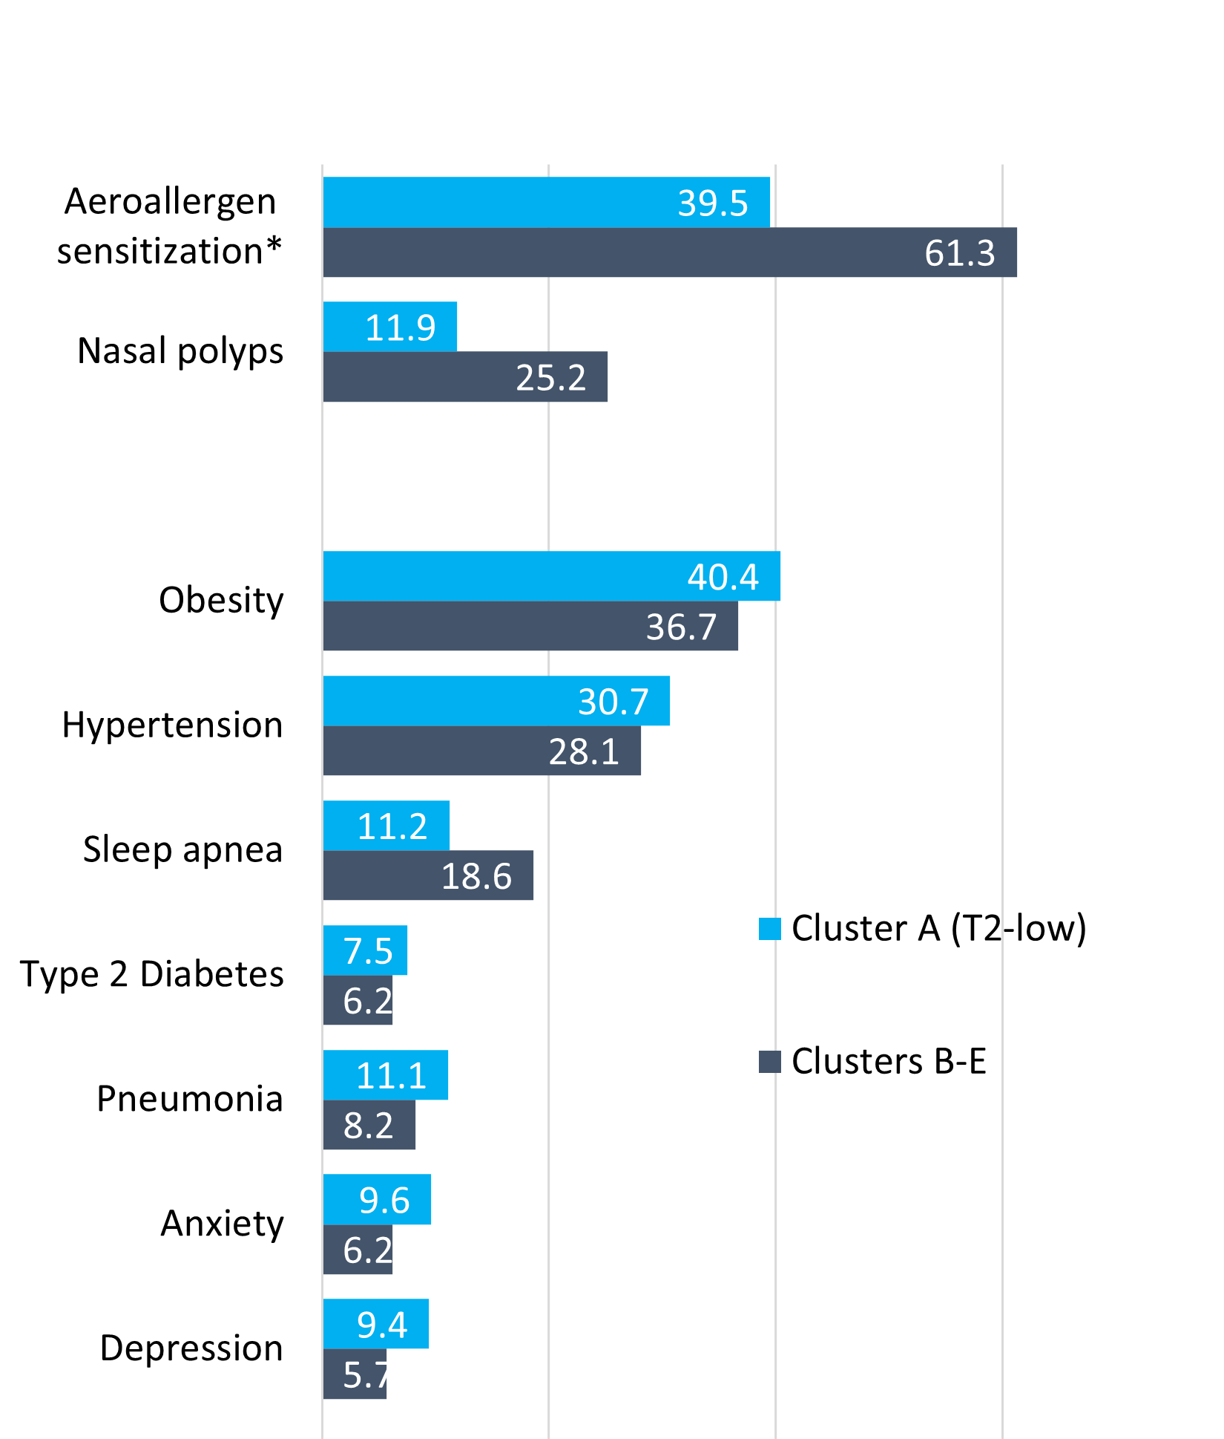

Demographic and clinical characteristics of biomarker clusters (N=3,675)
Cluster A (vs other clusters)
More likely to have potentially OCS-related comorbidities
Less likely to have any diagnosed allergy* and nasal polyps
*Aeroallergen sensitization by skin prick testing or serum allergen testing
BEC: Blood eosinophil count; FeNO: Fractional exhaled nitric oxide; FEV₁: Forced expiratory volume in 1 second; FVC: Forced vital capacity; GERD: Gastroesophageal reflux disease; IgE: Immunoglobulin E; T2: Type 2
Wang E et al. on behalf of the ISAR EMBER Working Group. Response to biologics along a gradient of T2 involvement in patients with severe asthma: a data-driven biomarker clustering approach, JACI: In Practice 2025; in press

Slide 11
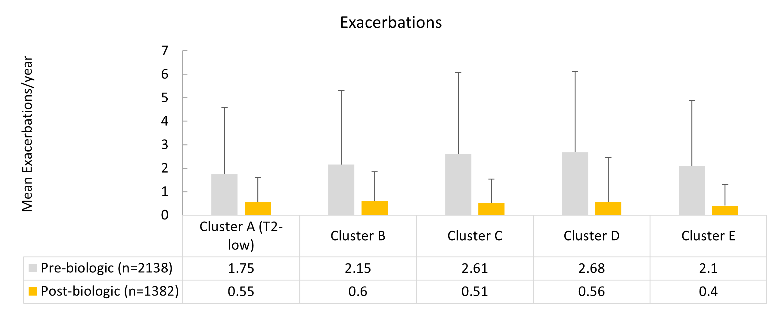
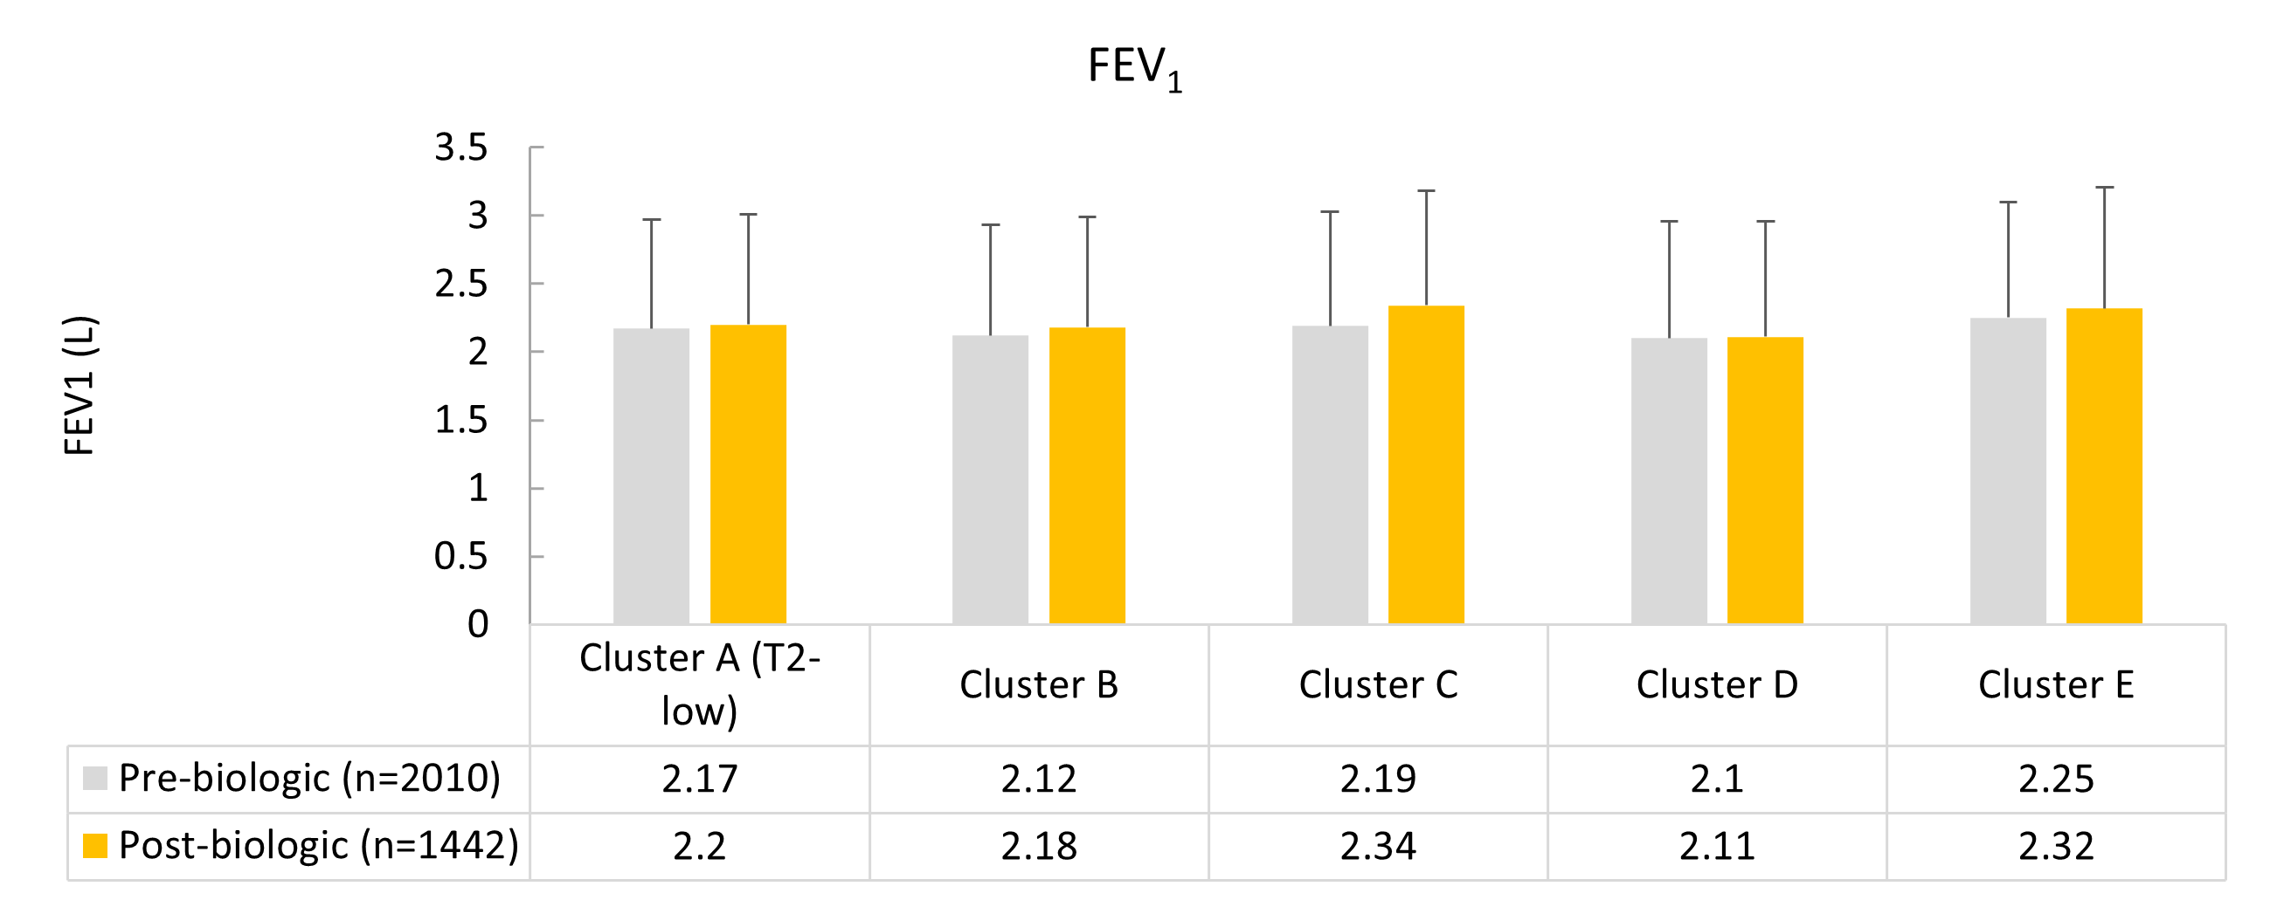
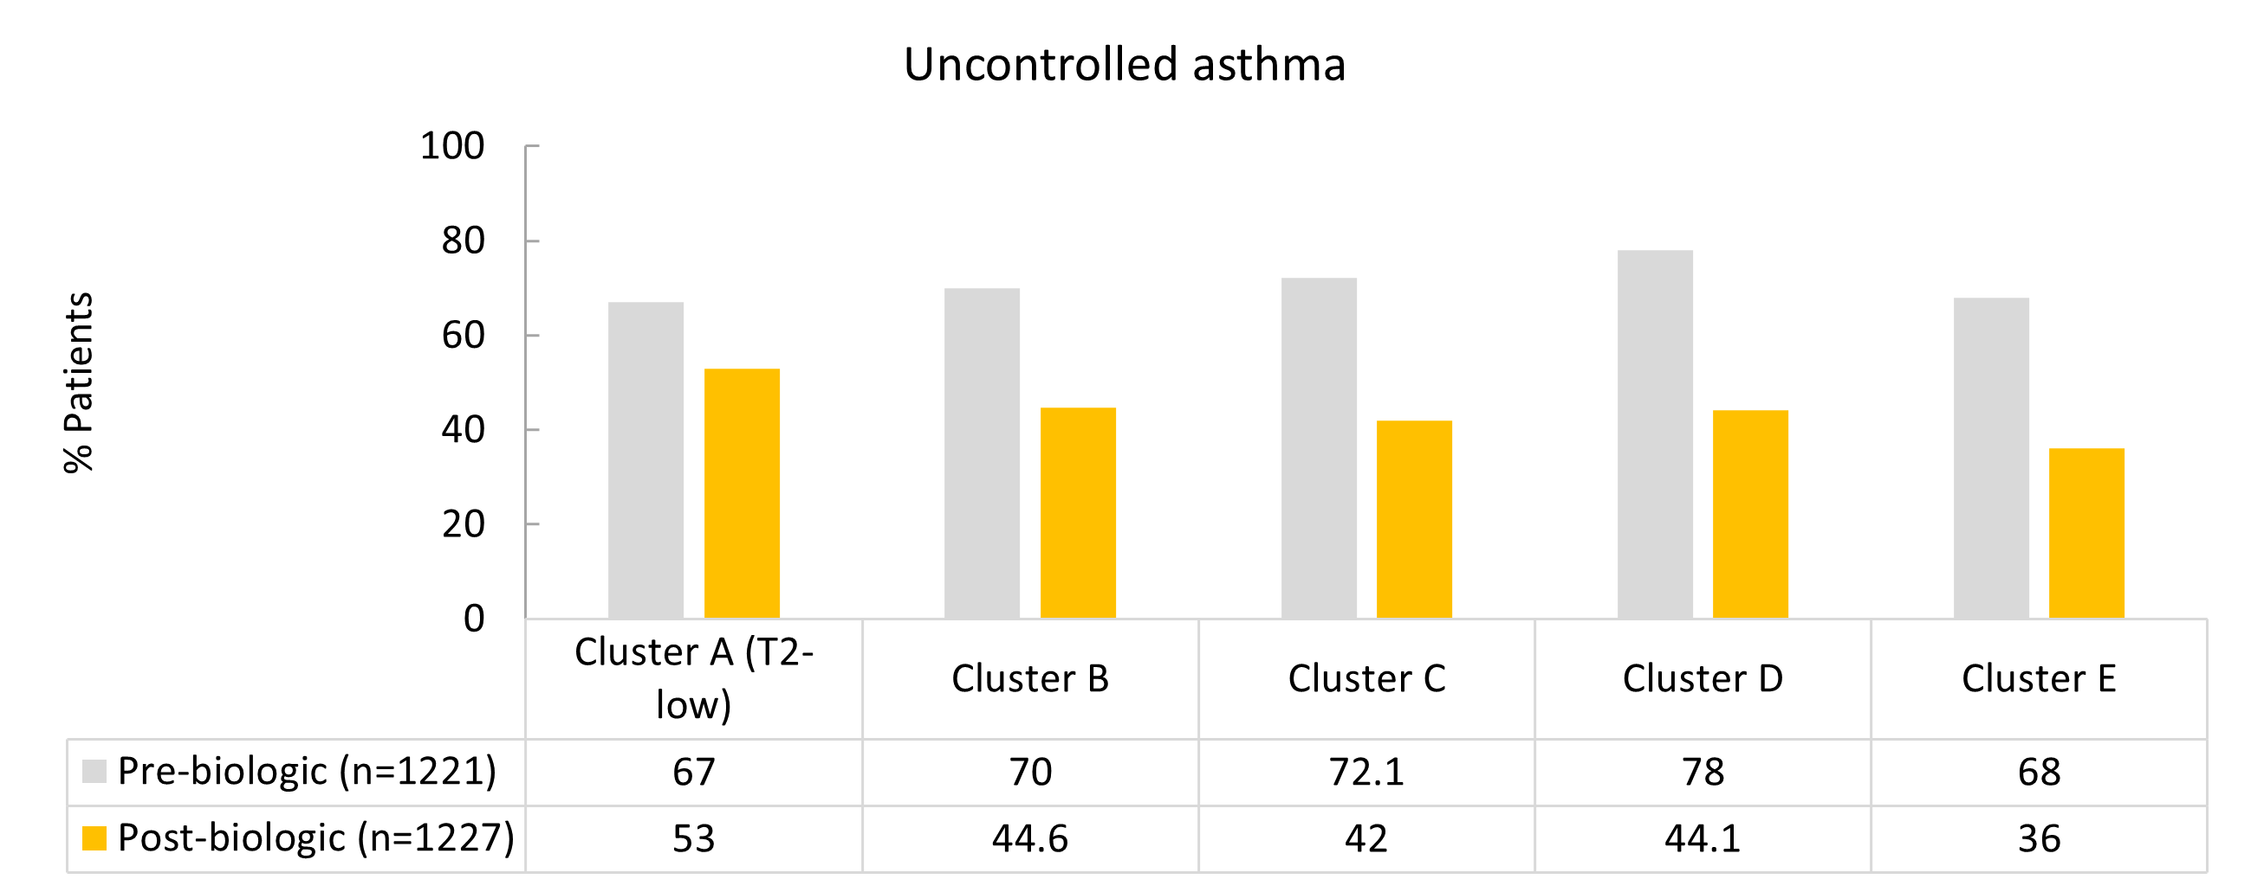
Pre- to post-biologic change in asthma outcomes for each cluster (univariate analysis)
Pre- to post-biologic improvements were shown for exacerbations, lung function and asthma control, irrespective of the degree of T2 involvement
FEV₁: Forced expiratory volume in 1 second; T2: Type 2
Wang E et al. on behalf of the ISAR EMBER Working Group. Response to biologics along a gradient of T2 involvement in patients with severe asthma: a data-driven biomarker clustering approach, JACI: In Practice 2025; in press

Slide 12
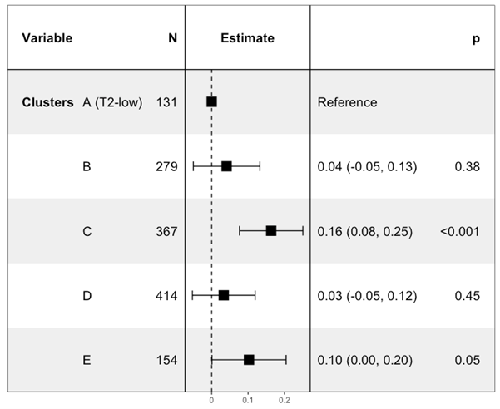
Pre- to post-biologic change in lung function relative to Cluster A (T2-low)
Patients in Cluster C (high BEC + FeNO) had a significantly greater increase in FEV₁ vs Cluster A
BEC: Blood eosinophil count; FeNO: Fractional exhaled nitric oxide; FEV₁: Forced expiratory volume in 1 second; T2: Type 2
Wang E et al. on behalf of the ISAR EMBER Working Group. Response to biologics along a gradient of T2 involvement in patients with severe asthma: a data-driven biomarker clustering approach, JACI: In Practice 2025; in press

Slide 13
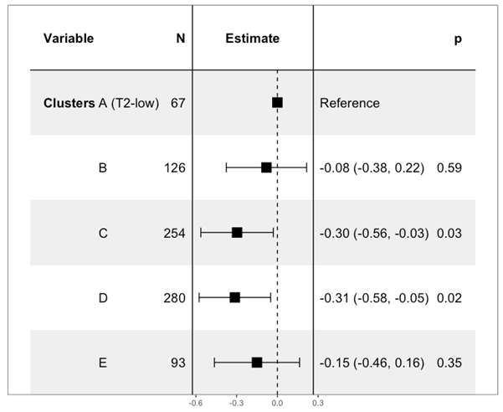
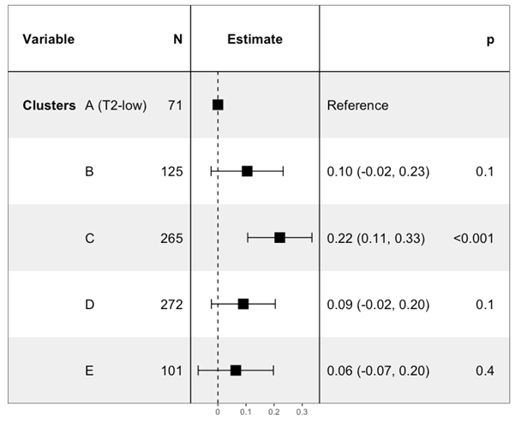
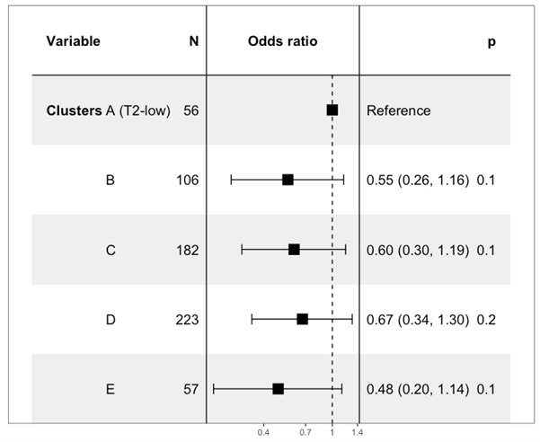
Pre- to post-biologic change in asthma outcomes relative to Cluster A (T2-low) for patients who received Anti-IL5/5R
Exacerbations
FEV₁
Uncontrolled asthma
Lower exacerbation rates and greater improvements in lung function and asthma control were noted for Anti–IL5/5R (but not Anti-IgE or Anti-IL4Rα) for all clusters relative to cluster A
FEV₁: Forced expiratory volume in 1 second; IgE: Immunoglobulin E; IL4Rα: Interleukin 4-receptor-alpha; IL5/5R: Interleukin 5/5-receptor; T2: Type 2
Wang E et al. on behalf of the ISAR EMBER Working Group. Response to biologics along a gradient of T2 involvement in patients with severe asthma: a data-driven biomarker clustering approach, JACI: In Practice 2025; in press

Slide 14
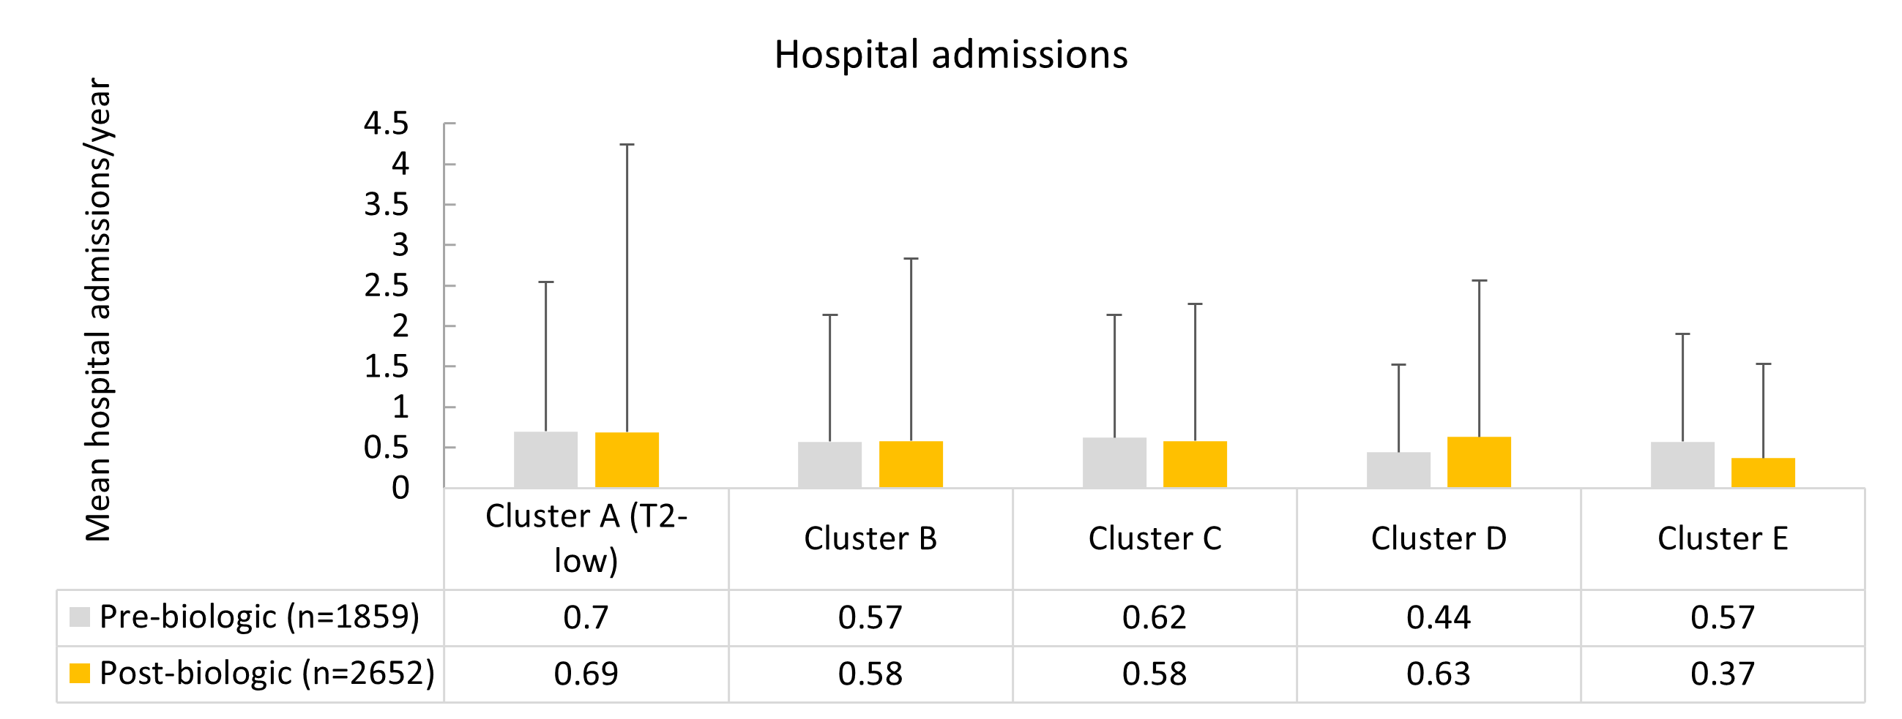
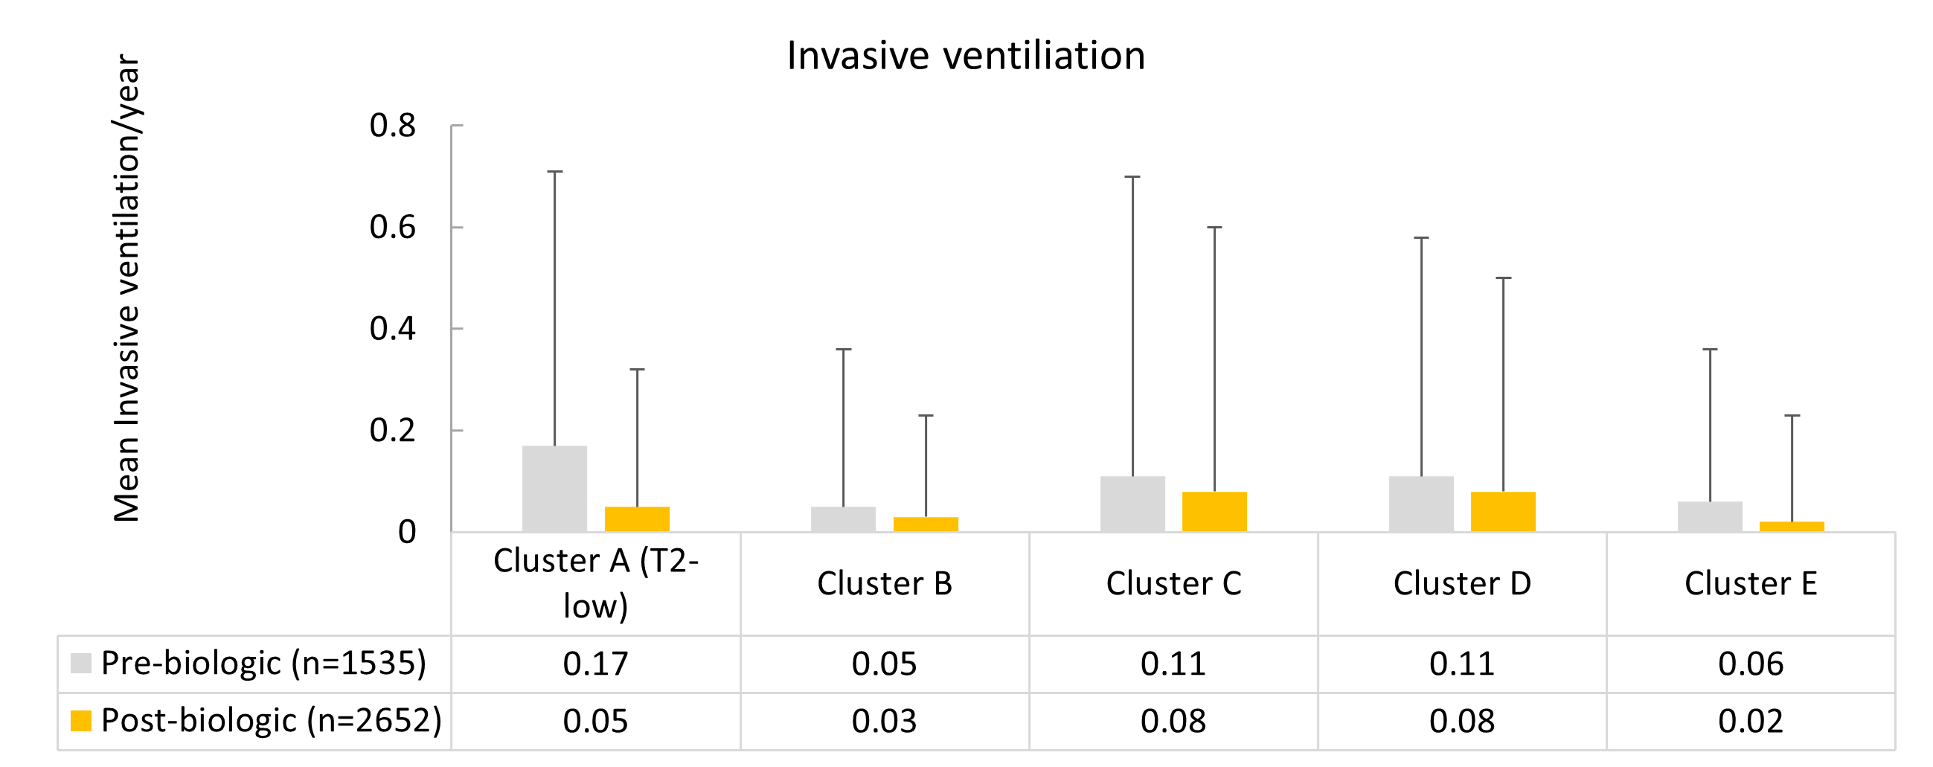
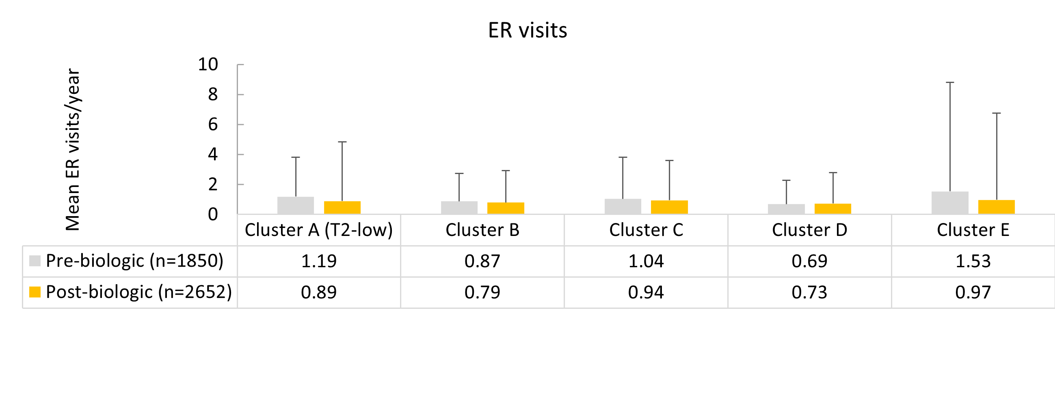
Pre- to post-biologic change in HCRU for each cluster (univariate analysis)
Pre- to post-biologic reductions were shown for hospitalizations, ER visits and invasive ventilation, irrespective of the degree of T2 involvement
ER: Emergency room; HCRU: Healthcare resource utilization; T2: Type 2
Wang E et al. on behalf of the ISAR EMBER Working Group. Response to biologics along a gradient of T2 involvement in patients with severe asthma: a data-driven biomarker clustering approach, JACI: In Practice 2025; in press

Slide 15
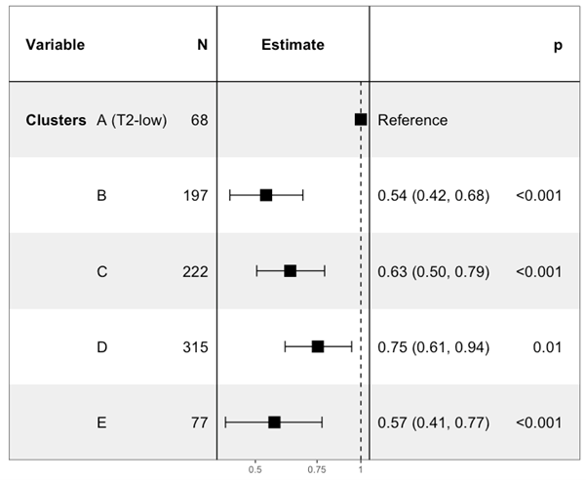
Pre- to post-biologic change in hospital admissions relative to Cluster A (T2-low)
Patients in clusters B, C, D and E had significantly greater reductions in hospital admissions for asthma vs Cluster A
T2: Type 2
Wang E et al. on behalf of the ISAR EMBER Working Group. Response to biologics along a gradient of T2 involvement in patients with severe asthma: a data-driven biomarker clustering approach, JACI: In Practice 2025; in press

Slide 16
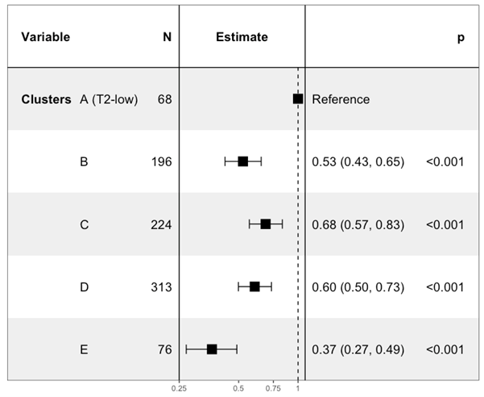
Pre- to post-biologic change in ER visits relative to Cluster A (T2-low)
Patients in clusters B, C, D and E had significantly greater reductions in ER visits vs Cluster A
ER: Emergency room; T2: Type 2
Wang E et al. on behalf of the ISAR EMBER Working Group. Response to biologics along a gradient of T2 involvement in patients with severe asthma: a data-driven biomarker clustering approach, JACI: In Practice 2025; in press

Slide 17




Conclusions
Five biomarker clusters along a gradient of T2 involvement were identified using a data-driven approach.
Biologic use was associated with improved outcomes in all clusters but tended to be better at the higher end of the T2 spectrum.
T2-targeted biologics have utility in the management of triple-biomarker-low asthma, but more effective therapies are needed.
Further research is needed to identify pathways specific to T2-low asthma that can be targeted by treatment.
T2: Type 2
Wang E et al. on behalf of the ISAR EMBER Working Group. Response to biologics along a gradient of T2 involvement in patients with severe asthma: a data-driven biomarker clustering approach, JACI: In Practice 2025; in press

